Slide 1
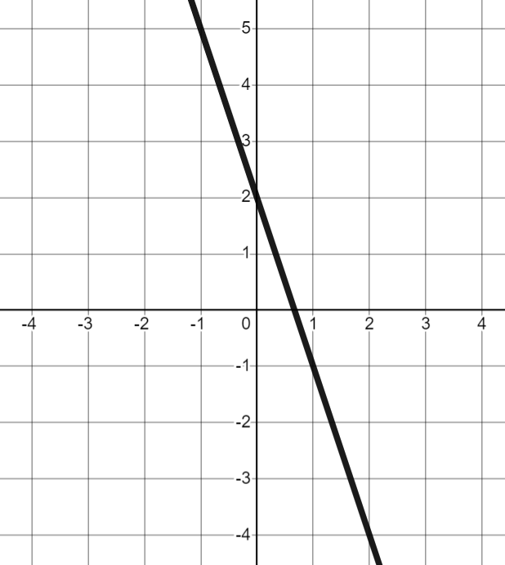
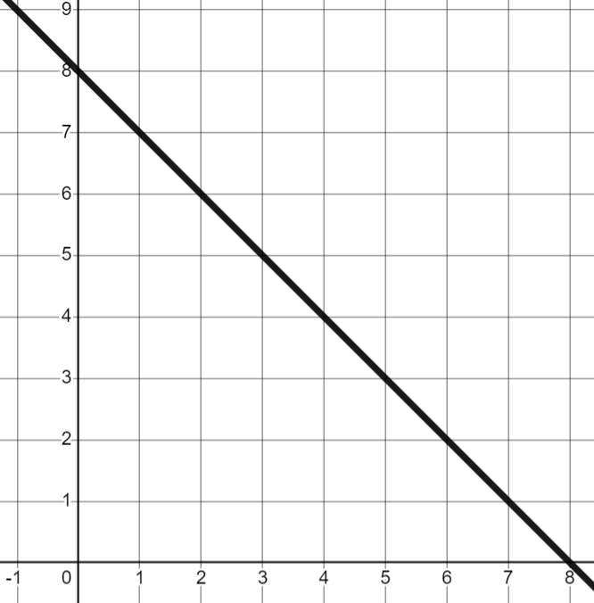
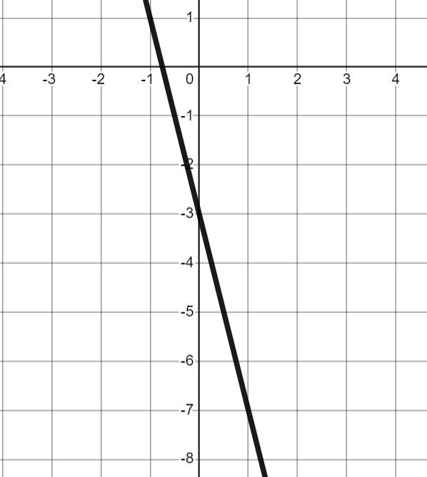
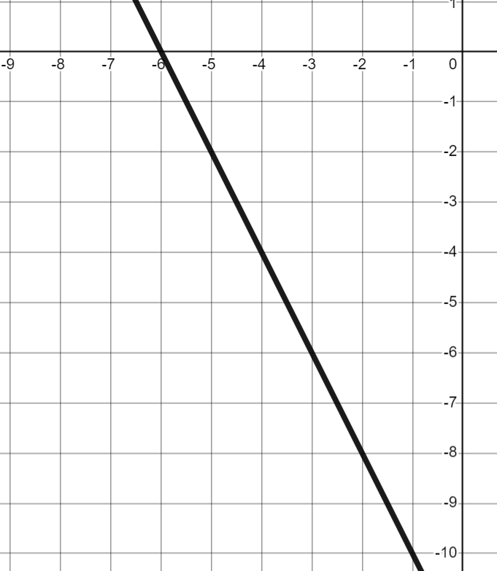
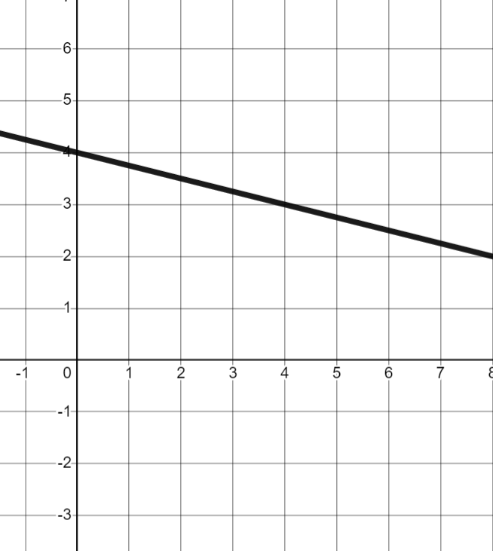
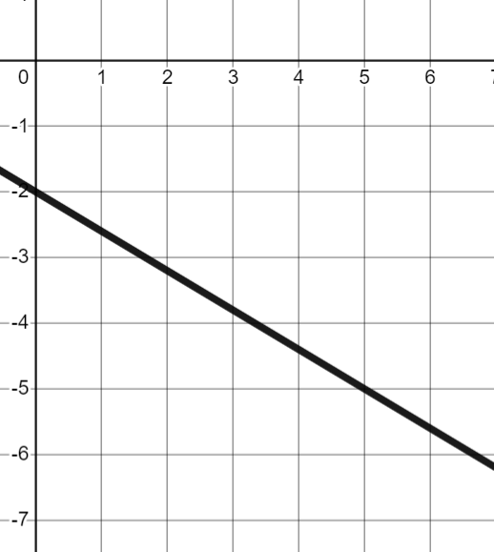
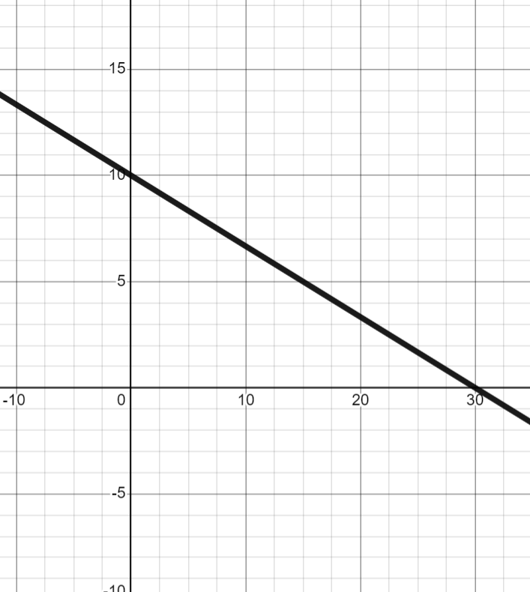
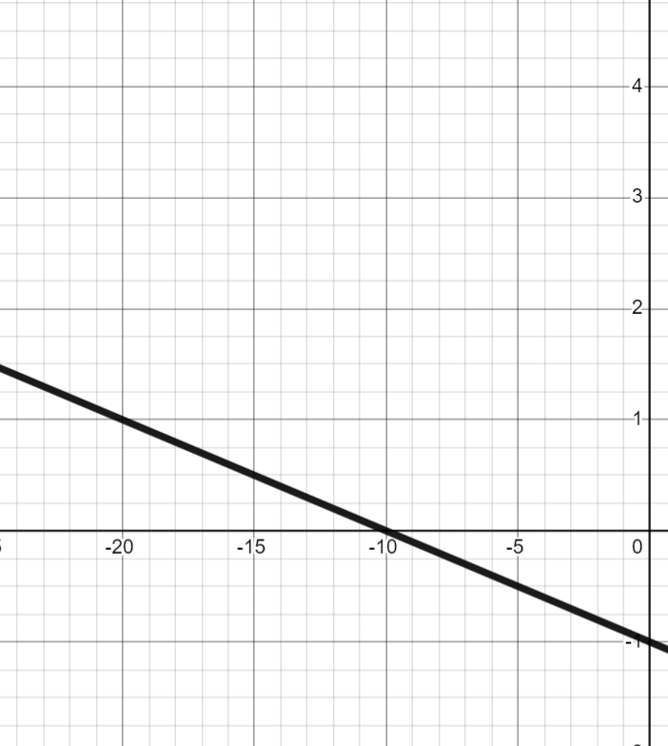
Negative rate of change from a graph
Task A: Calculating negative gradients from graphs
1) Find the gradient of each line.
a) | b) | c) | d)
e) | f) | g) | h)

Slide 2
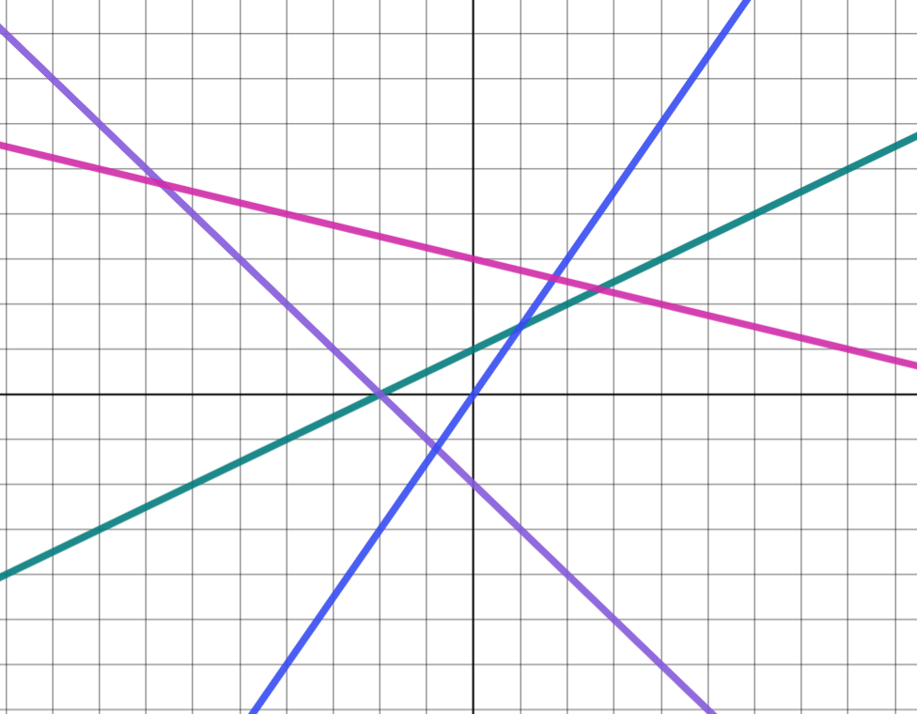

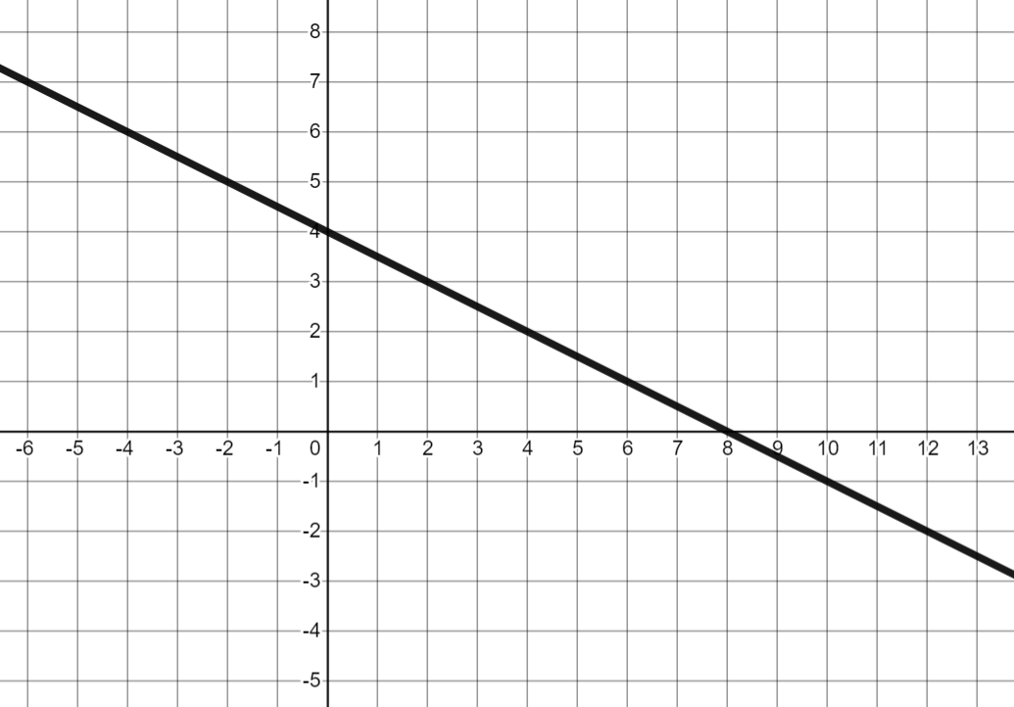
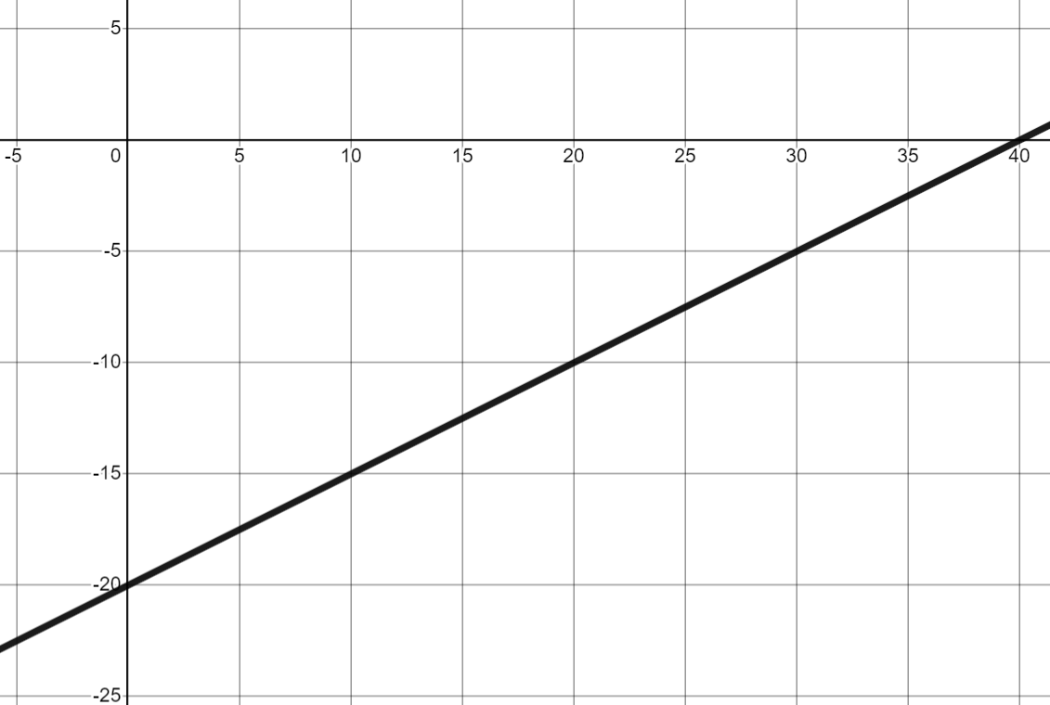
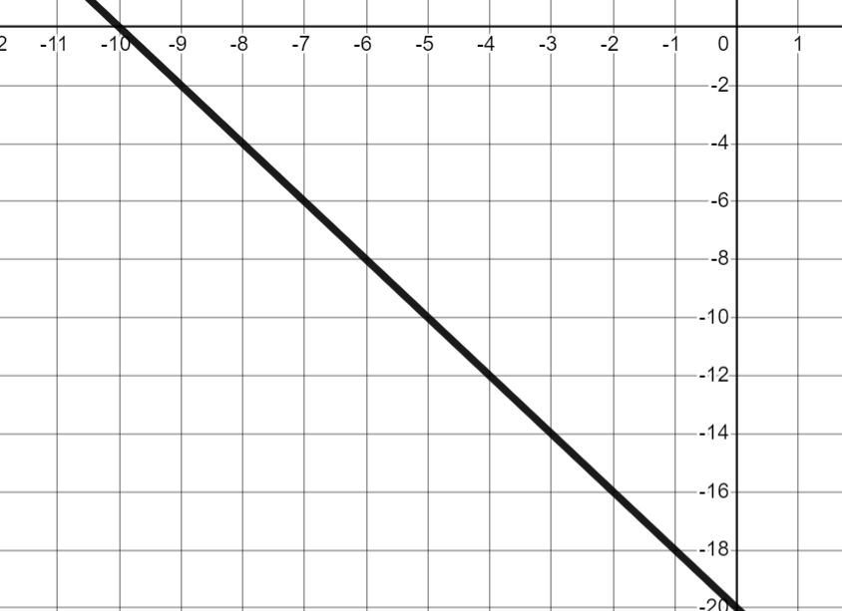
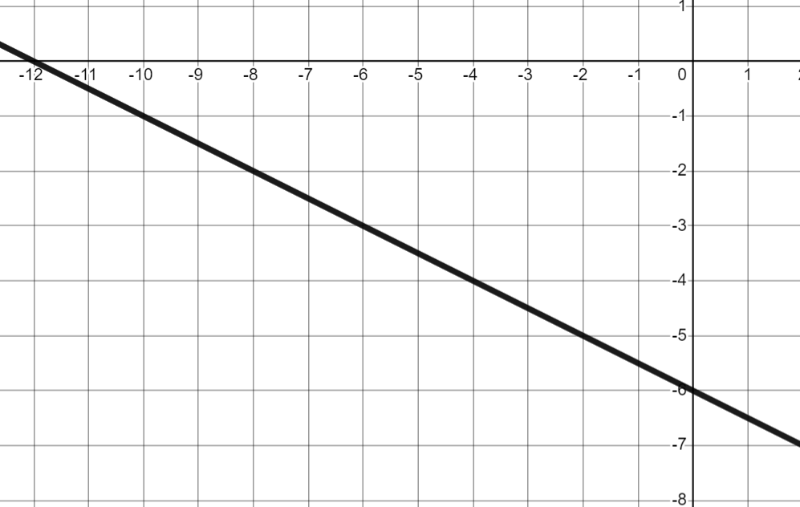
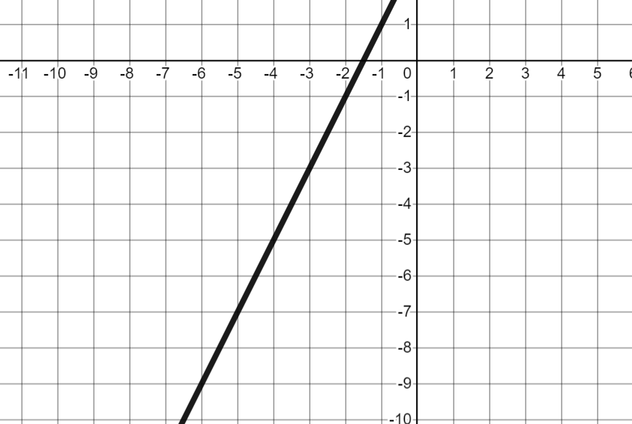
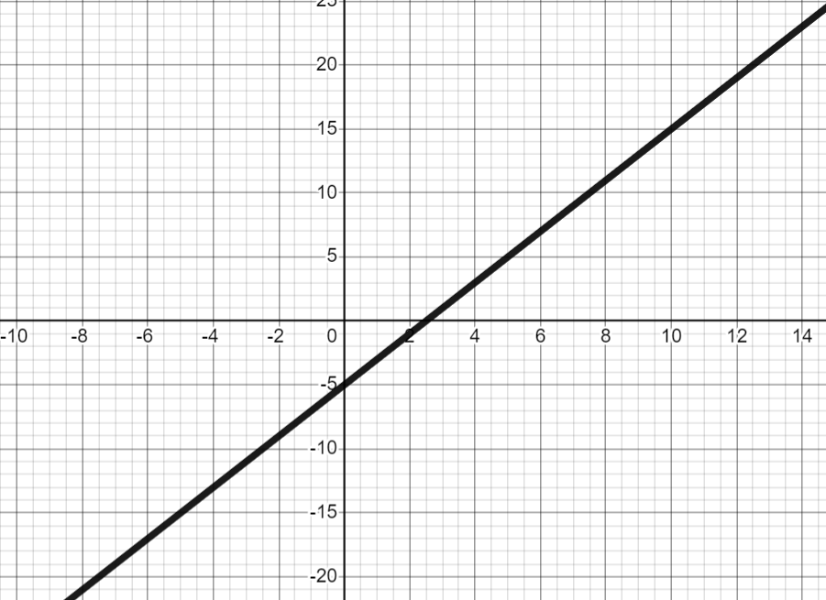

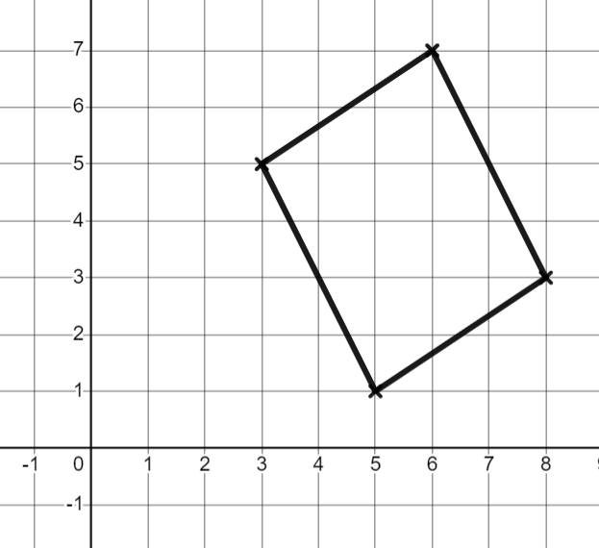

Negative rate of change from a graph
Task B: Calculating gradient from any graph
1) Four lines have been drawn on a set of axes with unknown scale. Match each line to its gradient.
D
gradient = 1
gradient = 3
gradient = −2
gradient =
C
B
A
2) Which lines are parallel?
Calculate the gradients and match any parallel lines.
A
B
C
D
E
F
3) Andeep is trying to prove this shape is a parallelogram
Finish off his working out.
Opposite sides in a parallelogram are parallel. Therefore they must have the same gradient.
−2
−2
The left and right sides are parallel…
Andeep
Mathematics in Education and Industry
v2.2

